Slide 1

C. T. Walker Traditional Magnet School Title I Annual Meeting
Day: Thursday
Date: September 4, 2025
Time: 5:30PM
Location: CTW Auditorium

Slide 2


Slide 3
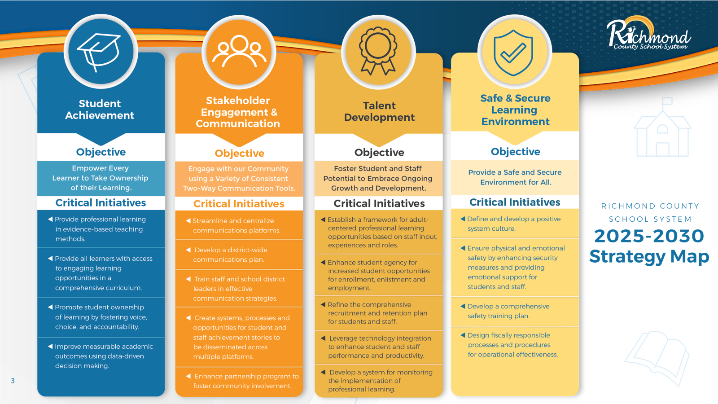

Slide 4
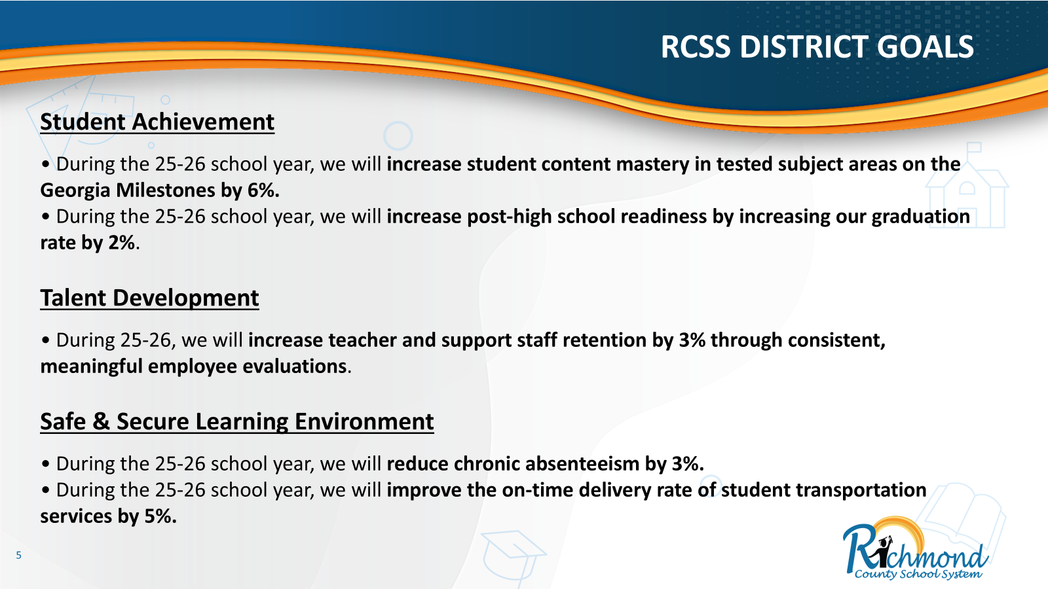
Richmond County School District Goals
Notes:
We encourage you to ask questions throughout the meeting. We value your input! We want to make sure you leave the meeting informed about the Title I program, as well as the opportunity to provide feedback.” Have parents to complete these surveys prior to leaving the meeting.
Mcallister

Slide 5
School Improvement Goals
By the end of the 2025-2026 academic school year, we will increase our reading achievement from 89% to 94% (669 students) as measured by the end of the year (EOY) iReady Reading Diagnostic Assessment.
By May 2026, we will increase in our mathematics achievement from 85% to 90% (641 students) as measured by the end of the year (EOY) iReady Math Diagnostic Assessment.
During the 2025-2026 academic school year, we will decrease the quantity of students absent 10 or more days from 9% to 5% (36 students) as measured by Infinite Campus.
Notes:
We encourage you to ask questions throughout the meeting. We value your input! We want to make sure you leave the meeting informed about the Title I program, as well as the opportunity to provide feedback.” Have parents to complete these surveys prior to leaving the meeting.
Mcallister

Slide 6

What is a Title I School?
Title I, Part A of the Every Student ​Succeeds Act of 2015 (ESSA) ​provides financial assistance to states and school districts. It’s overall purpose it to ensure that all children have a fair, equal, and significant opportunity to obtain a high-quality education and reach, at a minimum, proficiency on challenging state academic achievement standards and assessments.​
Notes:
We encourage you to ask questions throughout the meeting. We value your input! We want to make sure you leave the meeting informed about the Title I program, as well as the opportunity to provide feedback.” Have parents to complete these surveys prior to leaving the meeting.
Mcallister

Slide 7
Title I Funding
1% of the total District’s Title I funding is for Parent Involvement​.
Title I, Part A ​
Input from parents: On your evaluation forms, please share with us any ideas you have on how are $3,000 allocated for parental involvement can be utilized this academic year.
Notes:
We encourage you to ask questions throughout the meeting. We value your input! We want to make sure you leave the meeting informed about the Title I program, as well as the opportunity to provide feedback.” Have parents to complete these surveys prior to leaving the meeting.
Mcallister

Slide 8
How does the school spend funds?
Title I Part A
Title I funds are authorized and can be used to provide additional staff, professional development; instructional materials; improve curriculum; enhance parental involvement; extend learning time for students who need extra help; and provide other activities that are tied to raising student achievement on the State’s academic achievement standards.
Notes:
We encourage you to ask questions throughout the meeting. We value your input! We want to make sure you leave the meeting informed about the Title I program, as well as the opportunity to provide feedback.” Have parents to complete these surveys prior to leaving the meeting.
Mcallister

Slide 9

How does C. T. Walker Magnet participate?
Title I Schoolwide Program
Instructional Funds for Teachers to purchase supplemental instructional materials and supplies.
1 Reflection Room Paraprofessional who also supports instruction.
IXL Software for Students for Enrichment or Intervention on Reading, Math, Science, and Social Studies skills.
Heggerty as an additional phonics support for our Kindergarten and First Grade Teams.
Professional Learning for Teachers and for Substitutes for Teachers when they participate in Professional Learning.

Slide 10
Requirements For a Title I Schoolwide Program
Title I, Part A is part of the Elementary and Secondary Act of 1965 as amended by the Every Student Succeeds Act (ESSA). This Act provides Title I, Part A funds through the Georgia Department of Education (GaDOE) to Local Educational Agencies (LEAs) and public schools to help ensure that all children meet challenging State academic content and student academic achievement standards.
Serves all students in the school but requires special focus for lowest achieving schools.
Combines federal funds into total school budget
Is supplementary. The amount of Federal funds used in a schoolwide program must be supplemental to the amount of State and local funds the school would otherwise receive

Slide 11
Title I School-wide Program
School-wide goals
Programs/Supports in place to help our children
State’s Grade Report

Slide 12
Curriculum and Assessment
The School Curriculum is housed in Canvas for educators. Parents can access curriculum information from Teaching and Learning on the Richmond County website and under the Parents tab.
Assessments
– Various assessments measure our children’s progress
– Different proficiency level expectations based on the
grade of the student
Access student performance in Infinite Campus

Slide 13
Parent and Family Engagement
District Parent and Family Engagement Policy
Initiated by Title I and sent out by the school
Dissemination of state policies
School Parent and Family Engagement Policy
Gives information about stakeholders as they relate to Title I
Soliciting parent and community involvement in school
School/Parent Compact
An agreement between all stakeholders to ensure that students are meeting their educational goals.
Notes:
– Suggested language, “
This plan describes how the school will carry out its obligation to conduct outreach and provide activities, programs, and procedures to all parents of Title I students.
Johnson

Slide 14
School Parent and Family Engagement Policy
Each school that receives Title I funds must jointly develop, agree on with, and distribute to parents of children receiving services a written parental involvement policy. The school parental involvement policy describes how the school will carry out the parental involvement requirements to ensure effective involvement of parents and to support a partnership among the school, parents, and the community to improve student academic achievement.

Slide 15
School - Parent Compacts
Each school that receives Title I funds must jointly develop and revise with parents a school-parent compact as part of the school-level parental involvement policy. The school-parent compact is an agreement that outlines how parents, the entire school staff, and students will share the responsibility for improved student academic achievement and the means by which the school and parents will build and develop a partnership to help children achieve the state’s high standards.

Slide 16
Parent Right to Know
Rights to request teacher qualification
Notify if child has been taught by a non-highly qualified teacher for more than four weeks
Letters are sent home to parents at beginning of the school year. Letters were sent home on September 4, 2025.

Slide 17
Collaborative Effort
Planning is a mechanism for building a constituency to support school change and should involve school staff, parents, and the community.

Slide 18

Parent Decision Making Opportunities
Parents have a right to:
Request opportunities for regular meetings
Formulate and share suggestions
Be active participants in the educational decision-making process (via Title One school-wide committee, school council meetings, PTA, etc.)
Notes:
Simon

Slide 19

C. T. Walker Traditional Magnet School
Parent and Family Engagement
Title I programs bring parents, the community, and the school together to improve academic achievement of students.
We encourage your engagement in:
School Improvement Plan (SIP)
School Council
Committees
Notes:
We encourage you to ask questions throughout the meeting. We value your input! We want to make sure you leave the meeting informed about the Title I program, as well as the opportunity to provide feedback.”
Jackson

Slide 20
Dr. Alfreda Howard, Principal & Title 1 Contact for C.T. Walker HOWARAL2@BOE.RICHMOND.K12.GA.US 706-823-6950 Federal Programs Department 864 Broad Street​ (706) 826-1134​ Angeline Andrews-Milton, Federal Programs Director​ ​
Title I Contact Information

Slide 21
Please complete your evaluation before leaving…
Evaluations
Thank You!!!!!

